Slide 1
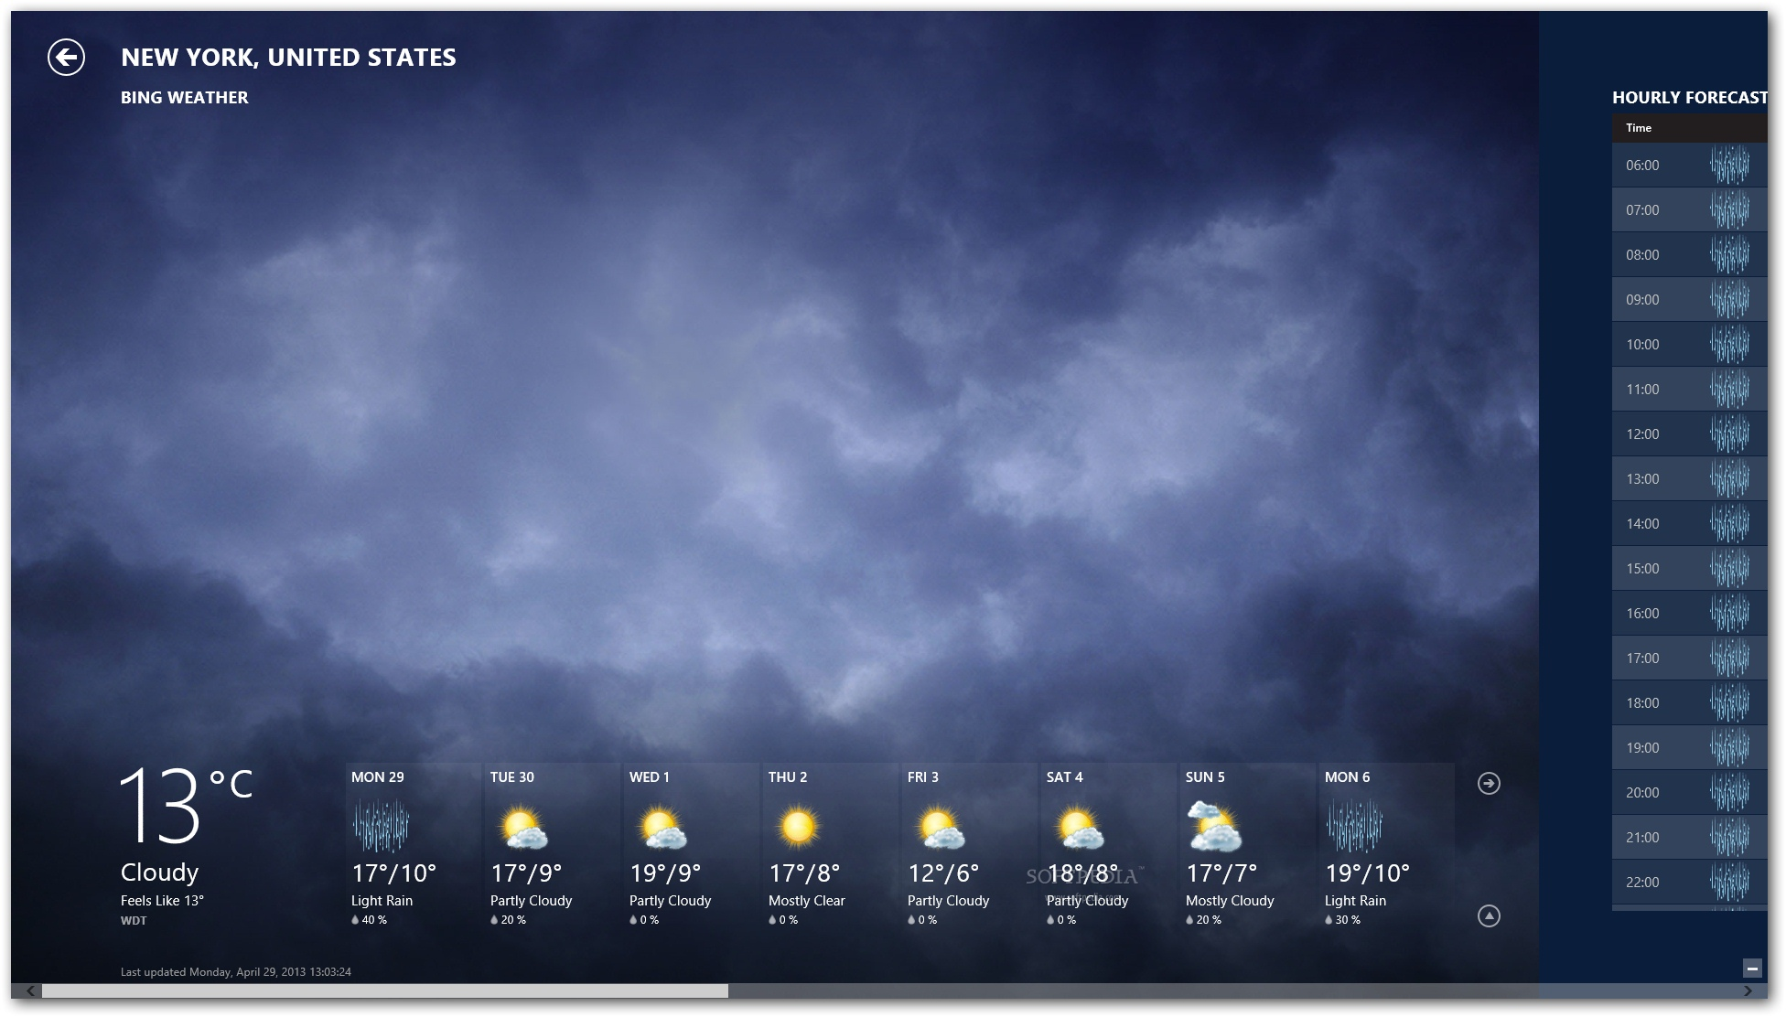

WeatherScape: Mapping the Weather Landscape
Team Members:
Japneet Kaur (2210990433)
Japneet Singh (2210990434)
Jasneet Arora (2210990451)
Submitted to:
Dr. Baljit Kaur
Mr. Vikas Patel

Slide 2

Table of Contents
Problem Statement
Introduction
Technical Details
Key Features
Dashboard Snapshots
Explore Our Project
References

Slide 3
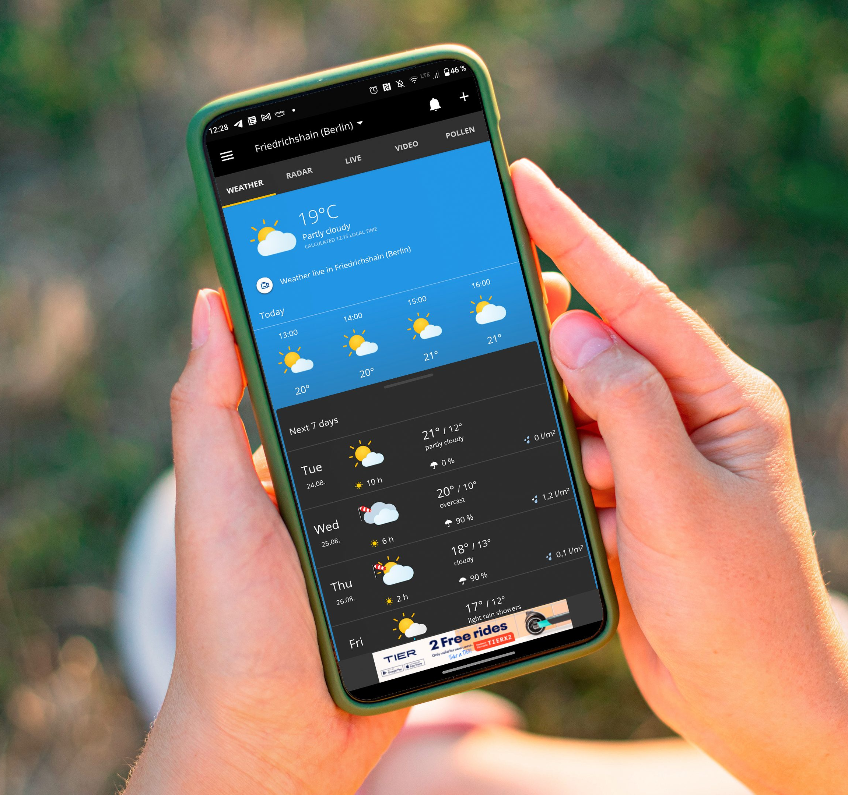
Problem Statement
The existing weather applications have the following limitations:
Limited Search Options: Not all apps offer zip code searches, restricting location flexibility.
Questionable Data: Inaccurate forecasts due to unreliable data sources in some apps.
Information Overload: Cluttered interfaces make it hard to find specific weather details.
Dull Design: Plain text interfaces make it difficult to visualize weather patterns quickly.

Slide 4
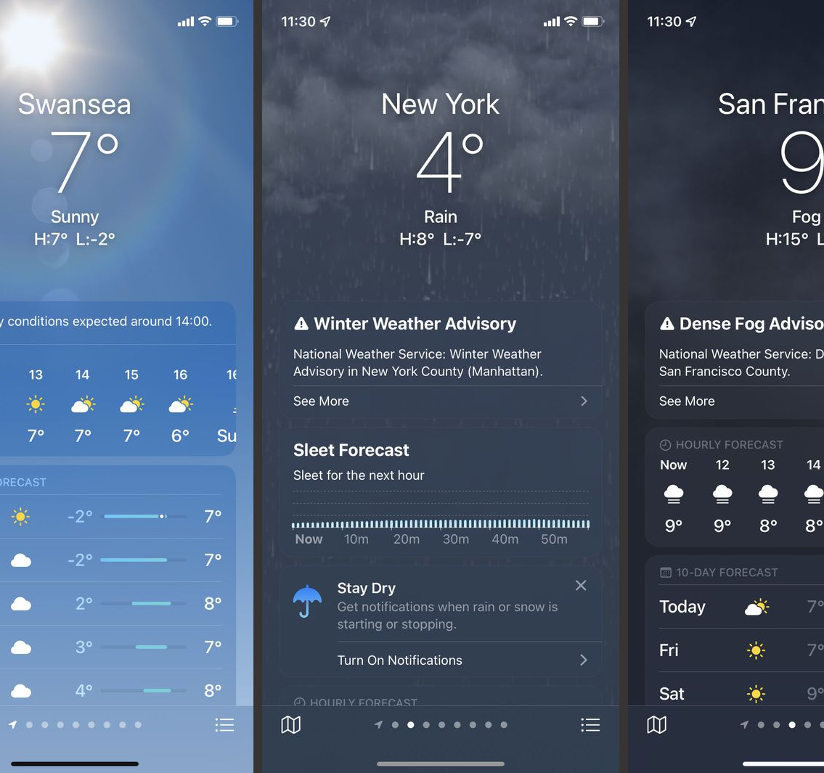
Introduction
Finding accurate and easy-to-understand weather information shouldn't be a chore. WeatherScape cuts through the clutter with:
Effortless Search: Effortlessly search by city name or zip code.
Data You Can Trust: Trustworthy forecasts using a reputable weather API.
Weather at a Glance: Dynamic icons and clear displays make understanding the weather quick and easy.

Slide 5

Technical Details
Frontend Technologies Used:
HTML: Structures the content of the project.
Tailwind CSS: Styles the dashboard
JavaScript (JS): Makes the app interactive, responding to the actions.
React JS: A powerful library for user interfaces.
API Integration:
Visual Crossing Weather API: To fetch live weather data.
Tools Used:
VS Code: The primary code editor for developing the layout.
Web Browsers: To test the compatibility and performance of the project.

Slide 6
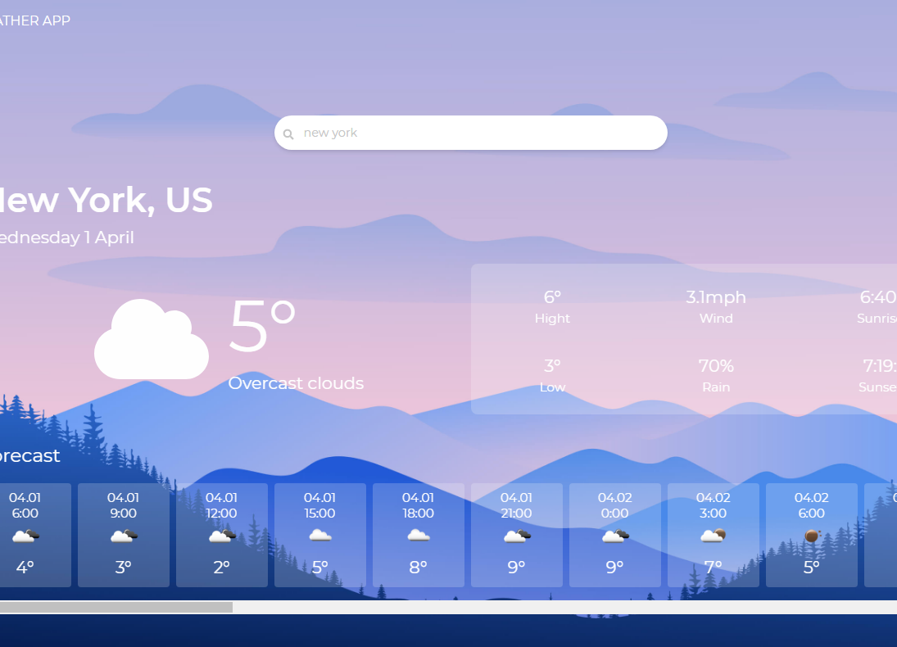
Key Features
WeatherScape goes beyond basic weather apps, offering a comprehensive suite of features:
Temperature: Precise temperature readings for the user's location
Precipitation: Detailed information on rainfall, snowfall, and other precipitation levels.
Wind Speed: Accurate measurements of wind speed and direction.
Forecast: Comprehensive weather forecasts for the next 7 days.

Slide 7
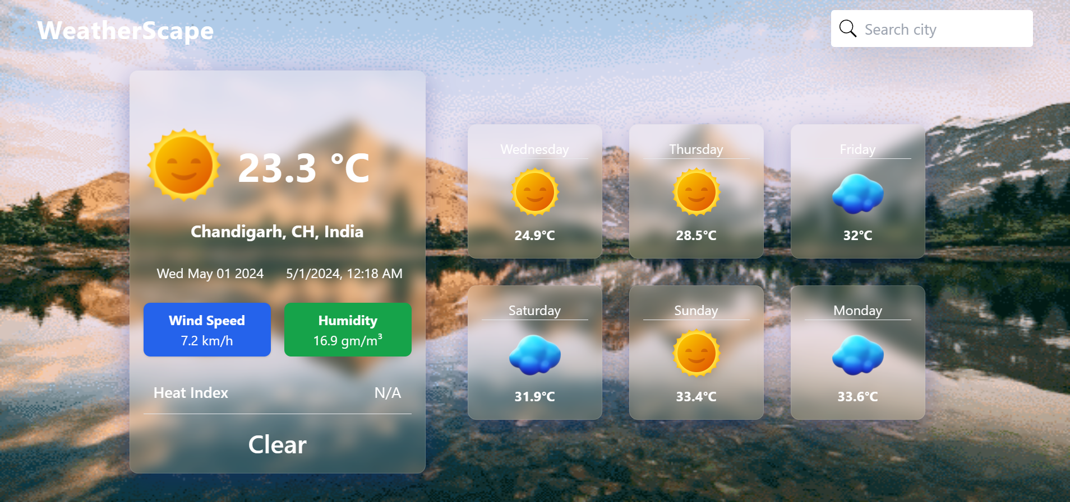
Dashboard Snapshots

Slide 8
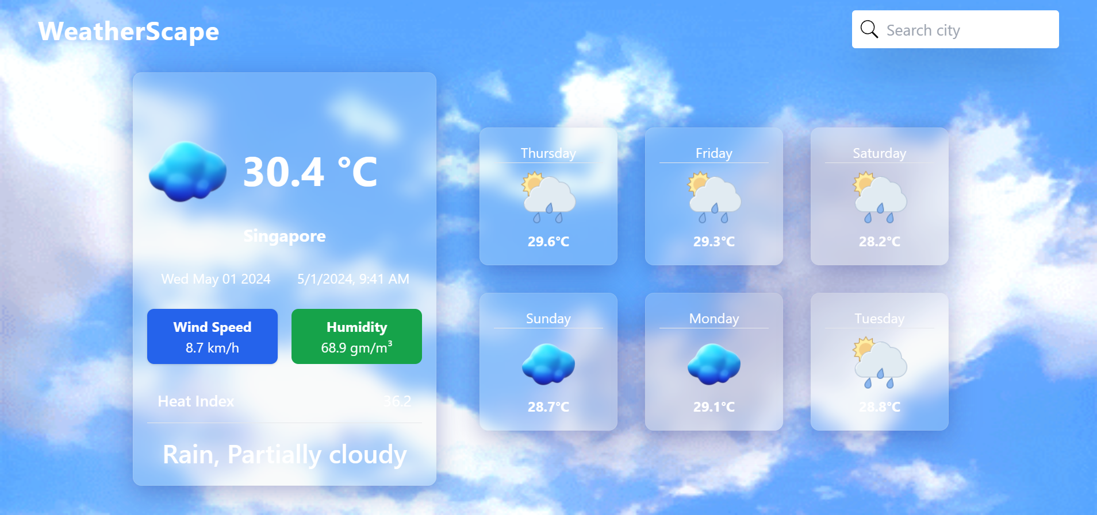
Dashboard Snapshots

Slide 9
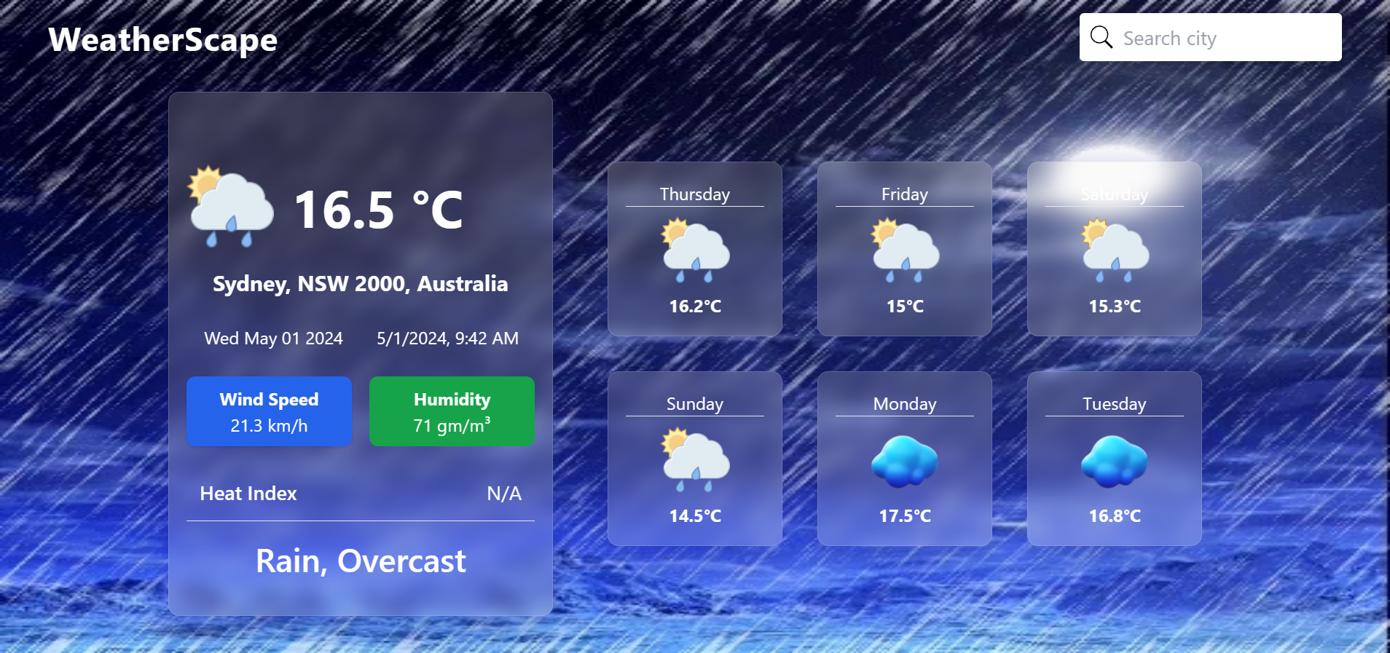
Dashboard Snapshots

Slide 10

Explore Our Project
GitHub Repository:
https://github.com/Japneet001/WeatherScape-Mapping-the-Weather-Landscape.git
Live Website Host Link:
https://weather-app-omega-two-12.vercel.app/

Slide 11

References
Youtube: https://www.youtube.com/
GitHub: https://www.github.com/
w3 Schools: https://www.w3schools.com/
Vercel: https://vercel.com/
API Used:
Visual Crossing Weather: https://visual-crossing-weather.p.rapidapi.com/forecast

Slide 12


